Slide 1
Sentencing
Guidelines
2022
What’s New
V C S C

Slide 2
What’s New 2022 – Sentencing Guidelines
MANDATORY MINIMUM FIELD
SWIFT will Calculate the Total Mandatory Minimums in a Sentencing Event
MODIFICATION OF RECOMMENDATION
SWIFT will Adjust Substantial Assistance, Acceptance of Responsibility or Expression of Remorse Recommendation for Mandatory Minimums and Sex Offender Risk Assessments
EARNED SENTENCE CREDIT
VCC Book and Databases will Distinguish Offenses that Require Defendants to Serve 85% vs 65%. SWIFT will Identify Offenses in the Future
AGGRAVATED MURDER
If aggravated murder is part of the sentencing event, there will be no guidelines recommendation. Only the cover sheet and case details worksheet is completed.
Several changes were made to SWIFT and the VCC book at the request of guidelines preparers

Slide 3
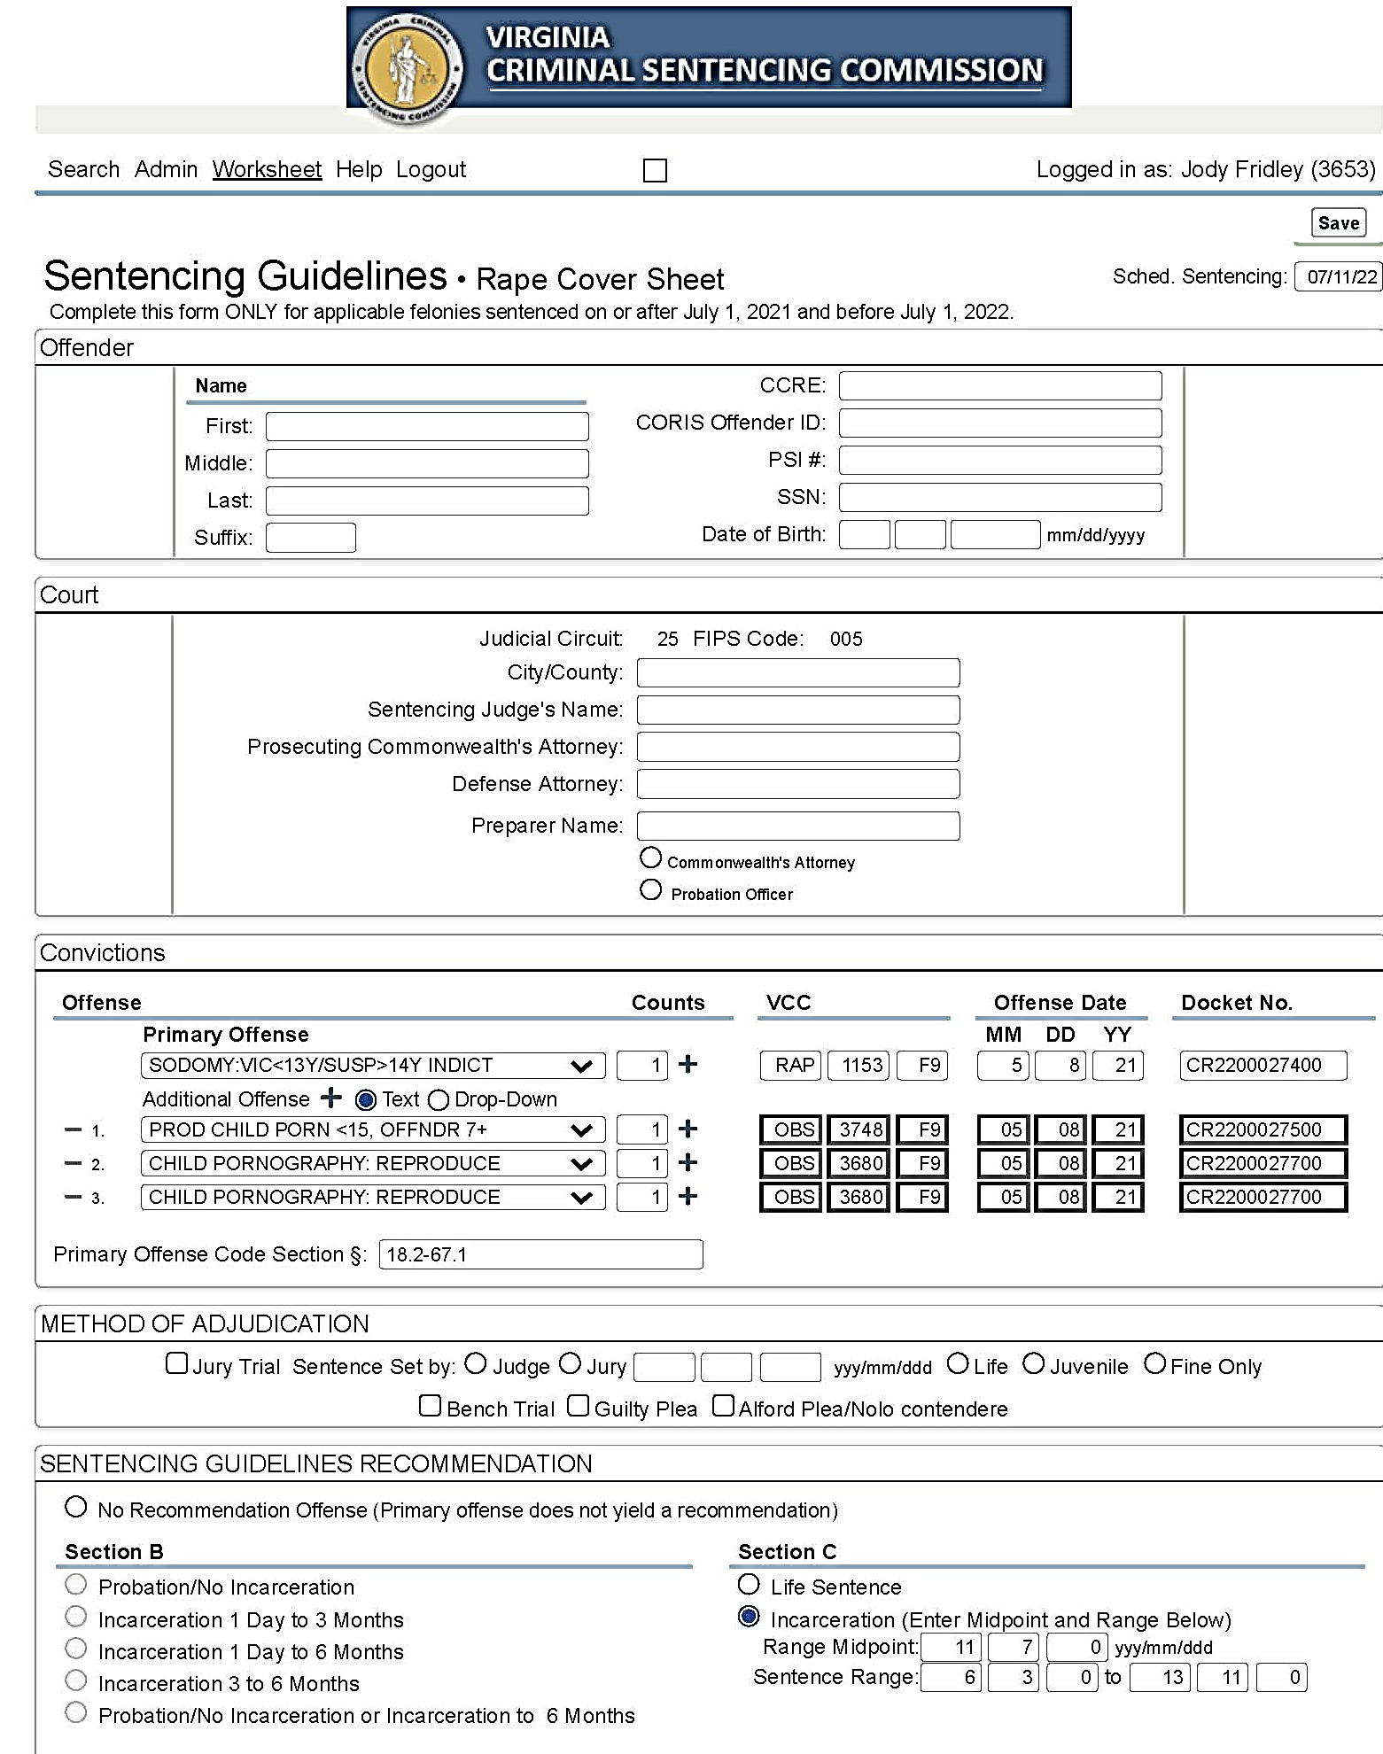
MANDATORY MINIMUM FIELD
Request: Users wanted SWIFT to identify and calculate the mandatory minimums in a sentencing event. Attorneys requested that the guidelines recommendation not be modified, but instead a field be added to identify the sum of all mandatory minimums in the event.
Solution
Calculate mandatory minimums for completed offenses and allow for a manual override when the mandatory sentence is not required by statute. The manual override is not used if the judge decides to run mandatory minimums concurrent to one another.
EXAMPLE § 18.2-248 (C,4) – Manual Override
The mandatory minimum term of imprisonment to be imposed for a violation of this subsection shall not be applicable if the court finds that:
a. The person does not have a prior conviction for an offense listed in subsection C of § 17.1-805;
b. The person did not use violence or credible threats of violence or possess a firearm or other dangerous weapon in connection with the offense or induce another participant in the offense to do so;
c. The offense did not result in death or serious bodily injury to any person;
d. The person was not an organizer, leader, manager, or supervisor of others in the offense, and was not engaged in a continuing criminal enterprise as defined in subsection I; and
e. Not later than the time of the sentencing hearing, the person has truthfully provided to the Commonwealth all information and evidence the person has concerning the offense or offenses that were part of the same course of conduct or of a common scheme or plan, but the fact that the person has no relevant or useful other information to provide or that the Commonwealth already is aware of the information shall not preclude a determination by the court that the defendant has complied with this requirement.
✓
✓

Slide 4
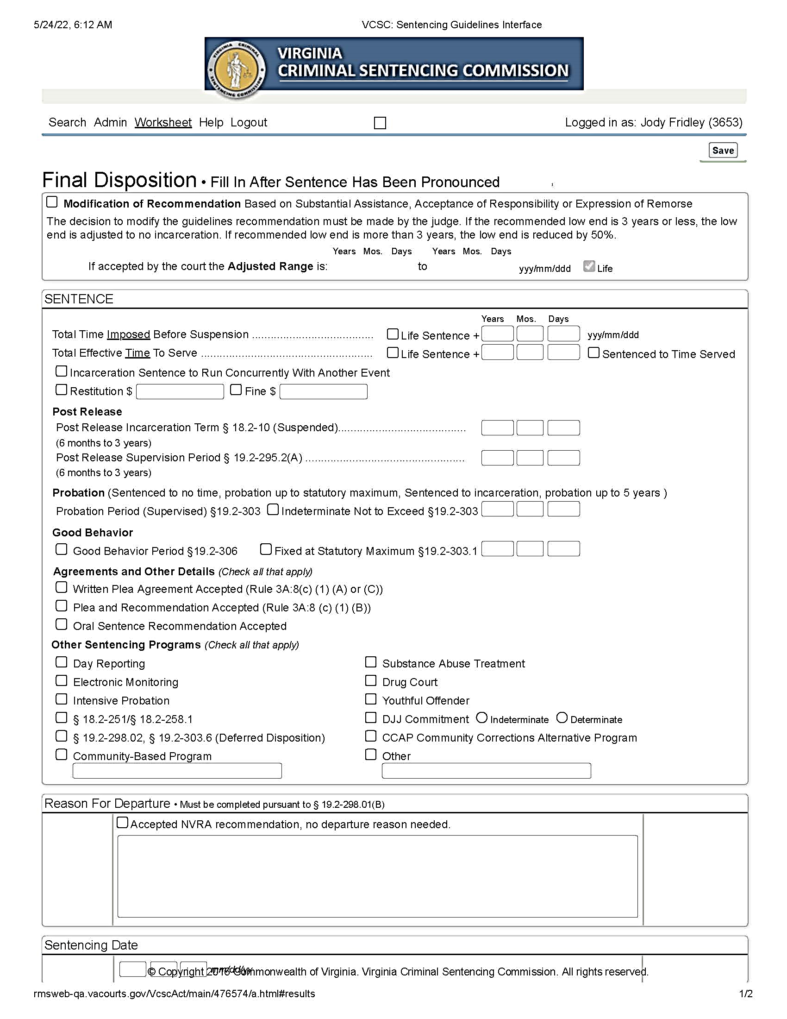
✓
Modification of Recommendation is adjusted to reflect any mandatory time the court must impose and cannot suspend
4

Slide 5
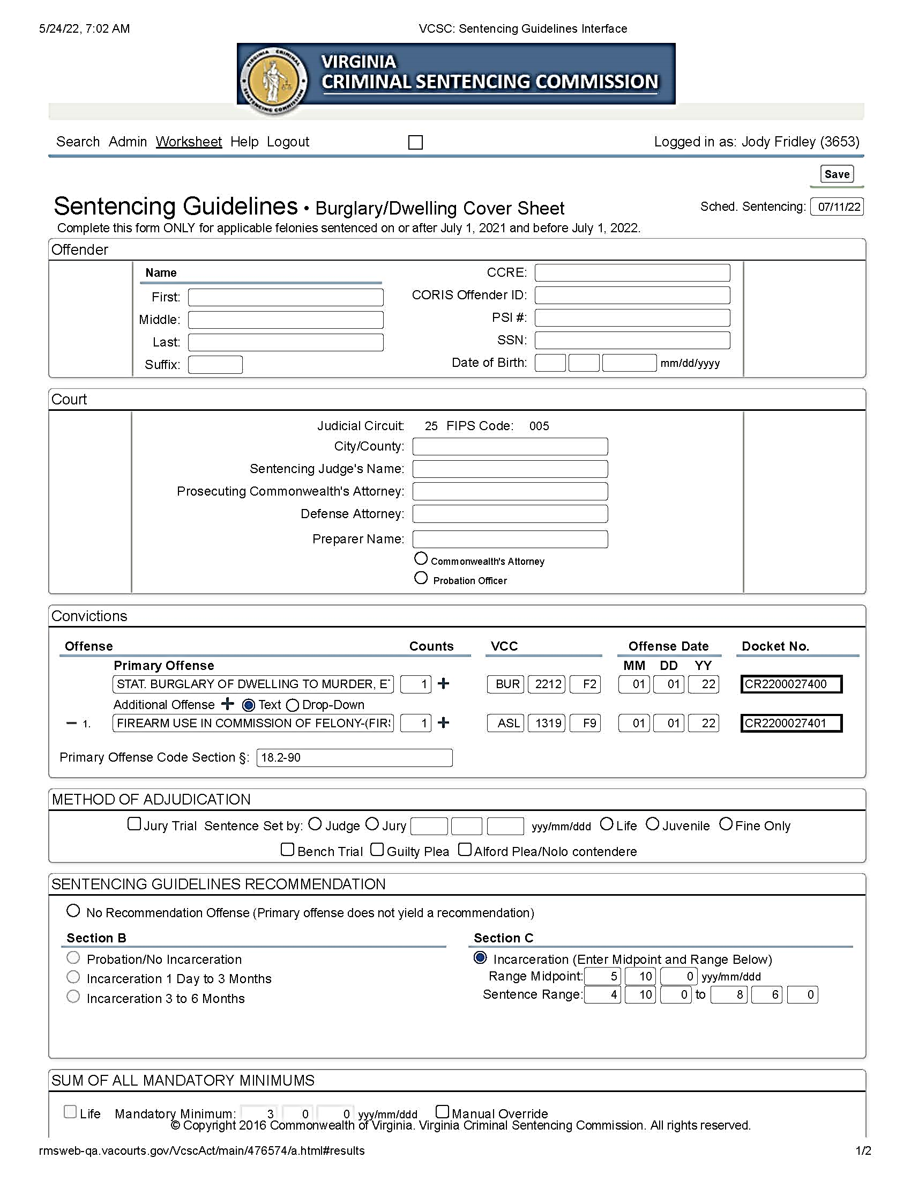
Another Example:
Use of Firearm in Commission of a Felony has a 3-Year Mandatory Minimum
Recommendation: 4Y 10M TO 8Y 6M
Modification of Recommendation: Will reflect mandatory minimums higher than the adjusted range (3Y Instead of 2Y 5M)
4

Slide 6
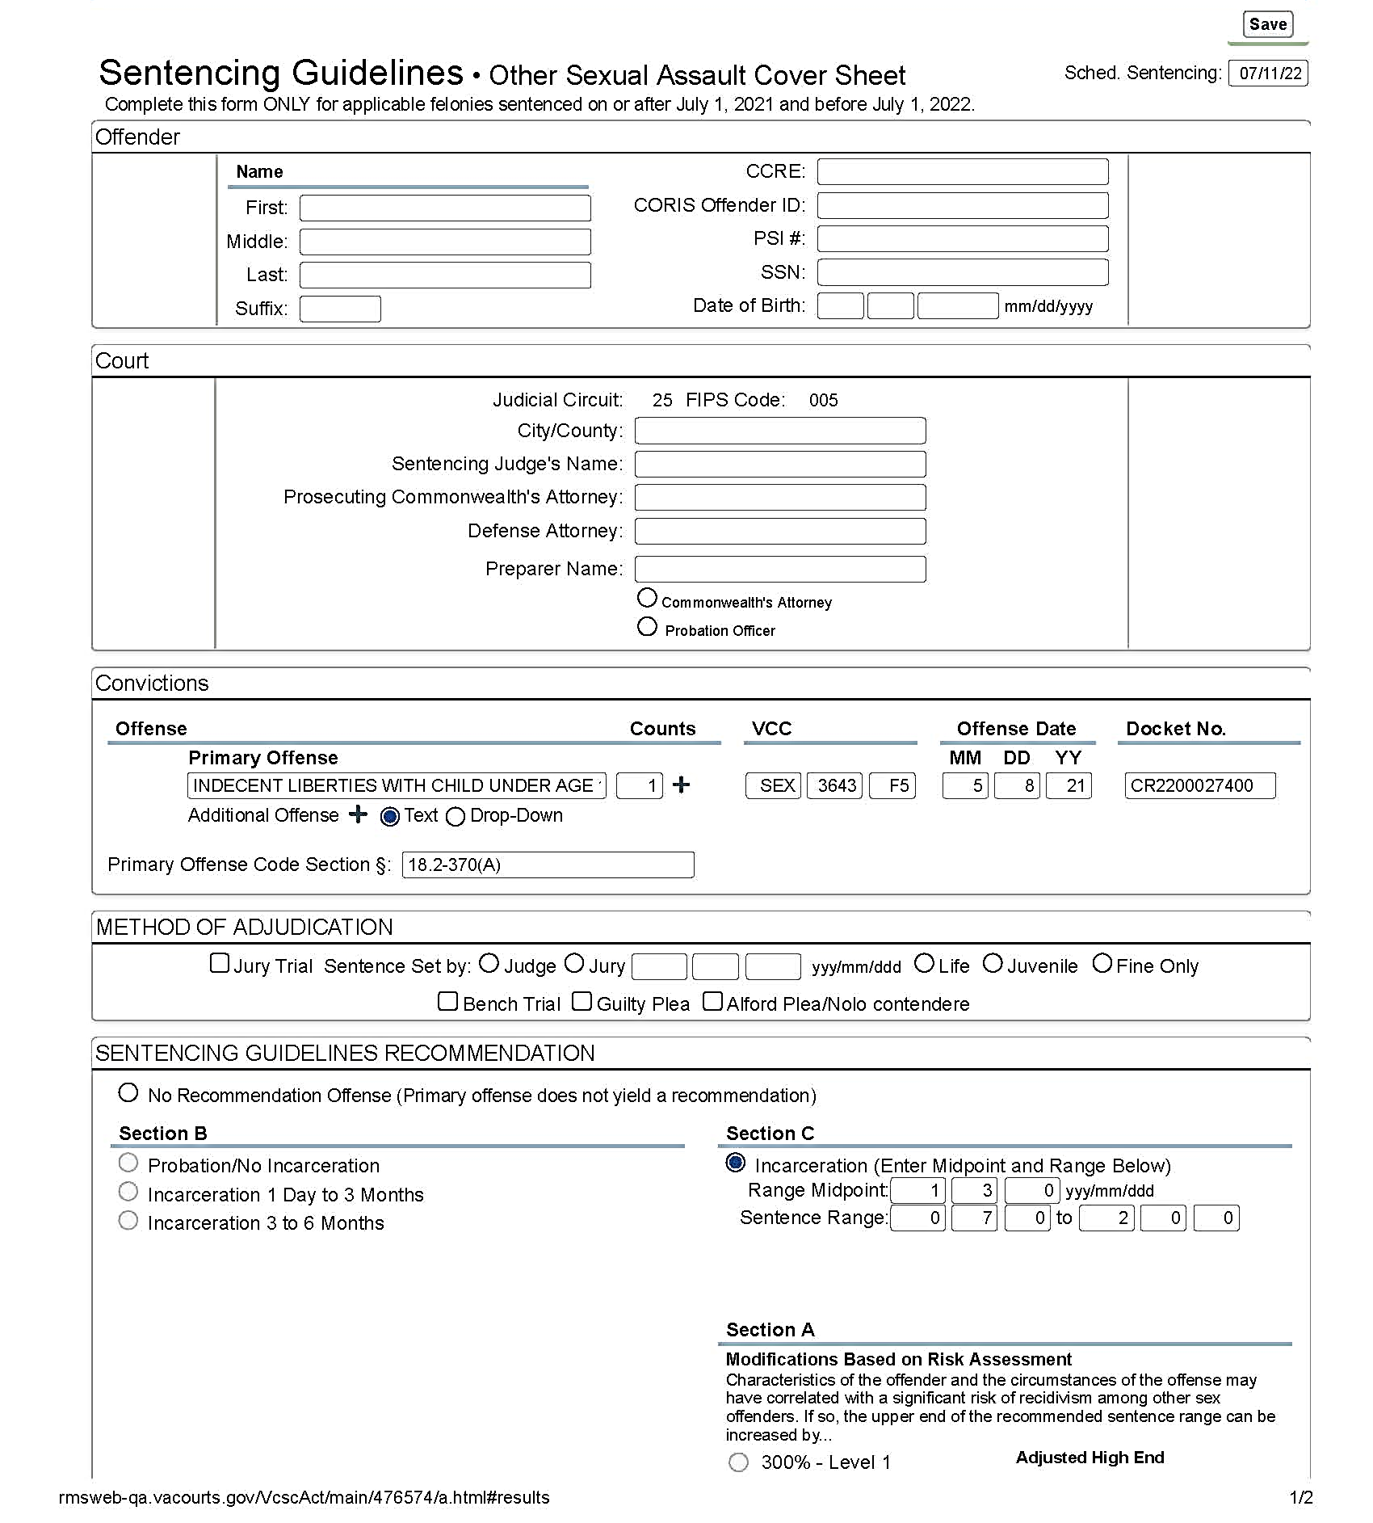
SEX OFFENDER RISK ASSESSMENT
Request: Users wanted the Modification of Recommendation to include the adjusted high end of the guidelines recommendation based on the sex offender risk assessment instrument.
Solution
SWIFT: The low end will remain the same, but the high end will reflect the true sentencing guidelines range.
✓
ADJUSTED HIGH END IS SET AT 4 YEARS
✓

Slide 7
Modification of Recommendation The low end is still zero, but the high end reflects the full range
ADJUSTED HIGH IS SET AT 4 YEARS
4

Slide 8
EARNED SENTENCE CREDIT (ESC)
Issue § 53.1-202.2 (et seq.): Beginning July 1, 2022, defendants will need to serve at least 65% of their sentence for certain felony offenses. In some of these cases the defendant must serve at least 85% for a second or subsequent offense in the group. Still in other cases defendants must continue to serve at least 85% of their sentence. Users wanted some way to distinguish the 65% offenses from the 85% offenses.
Immediate Solution: Identify the 85% cases in the Virginia Crime Code Book (VCC). Distinguish between the 85% ESC offenses for a second or subsequent and the offenses that continue to require defendants serve at least 85% of their felony sentence.
Future Solution
Incorporate the logic used in the VCC book into the Docket Detail page generated in SWIFT. This will not occur by July 1, 2022.

Slide 9
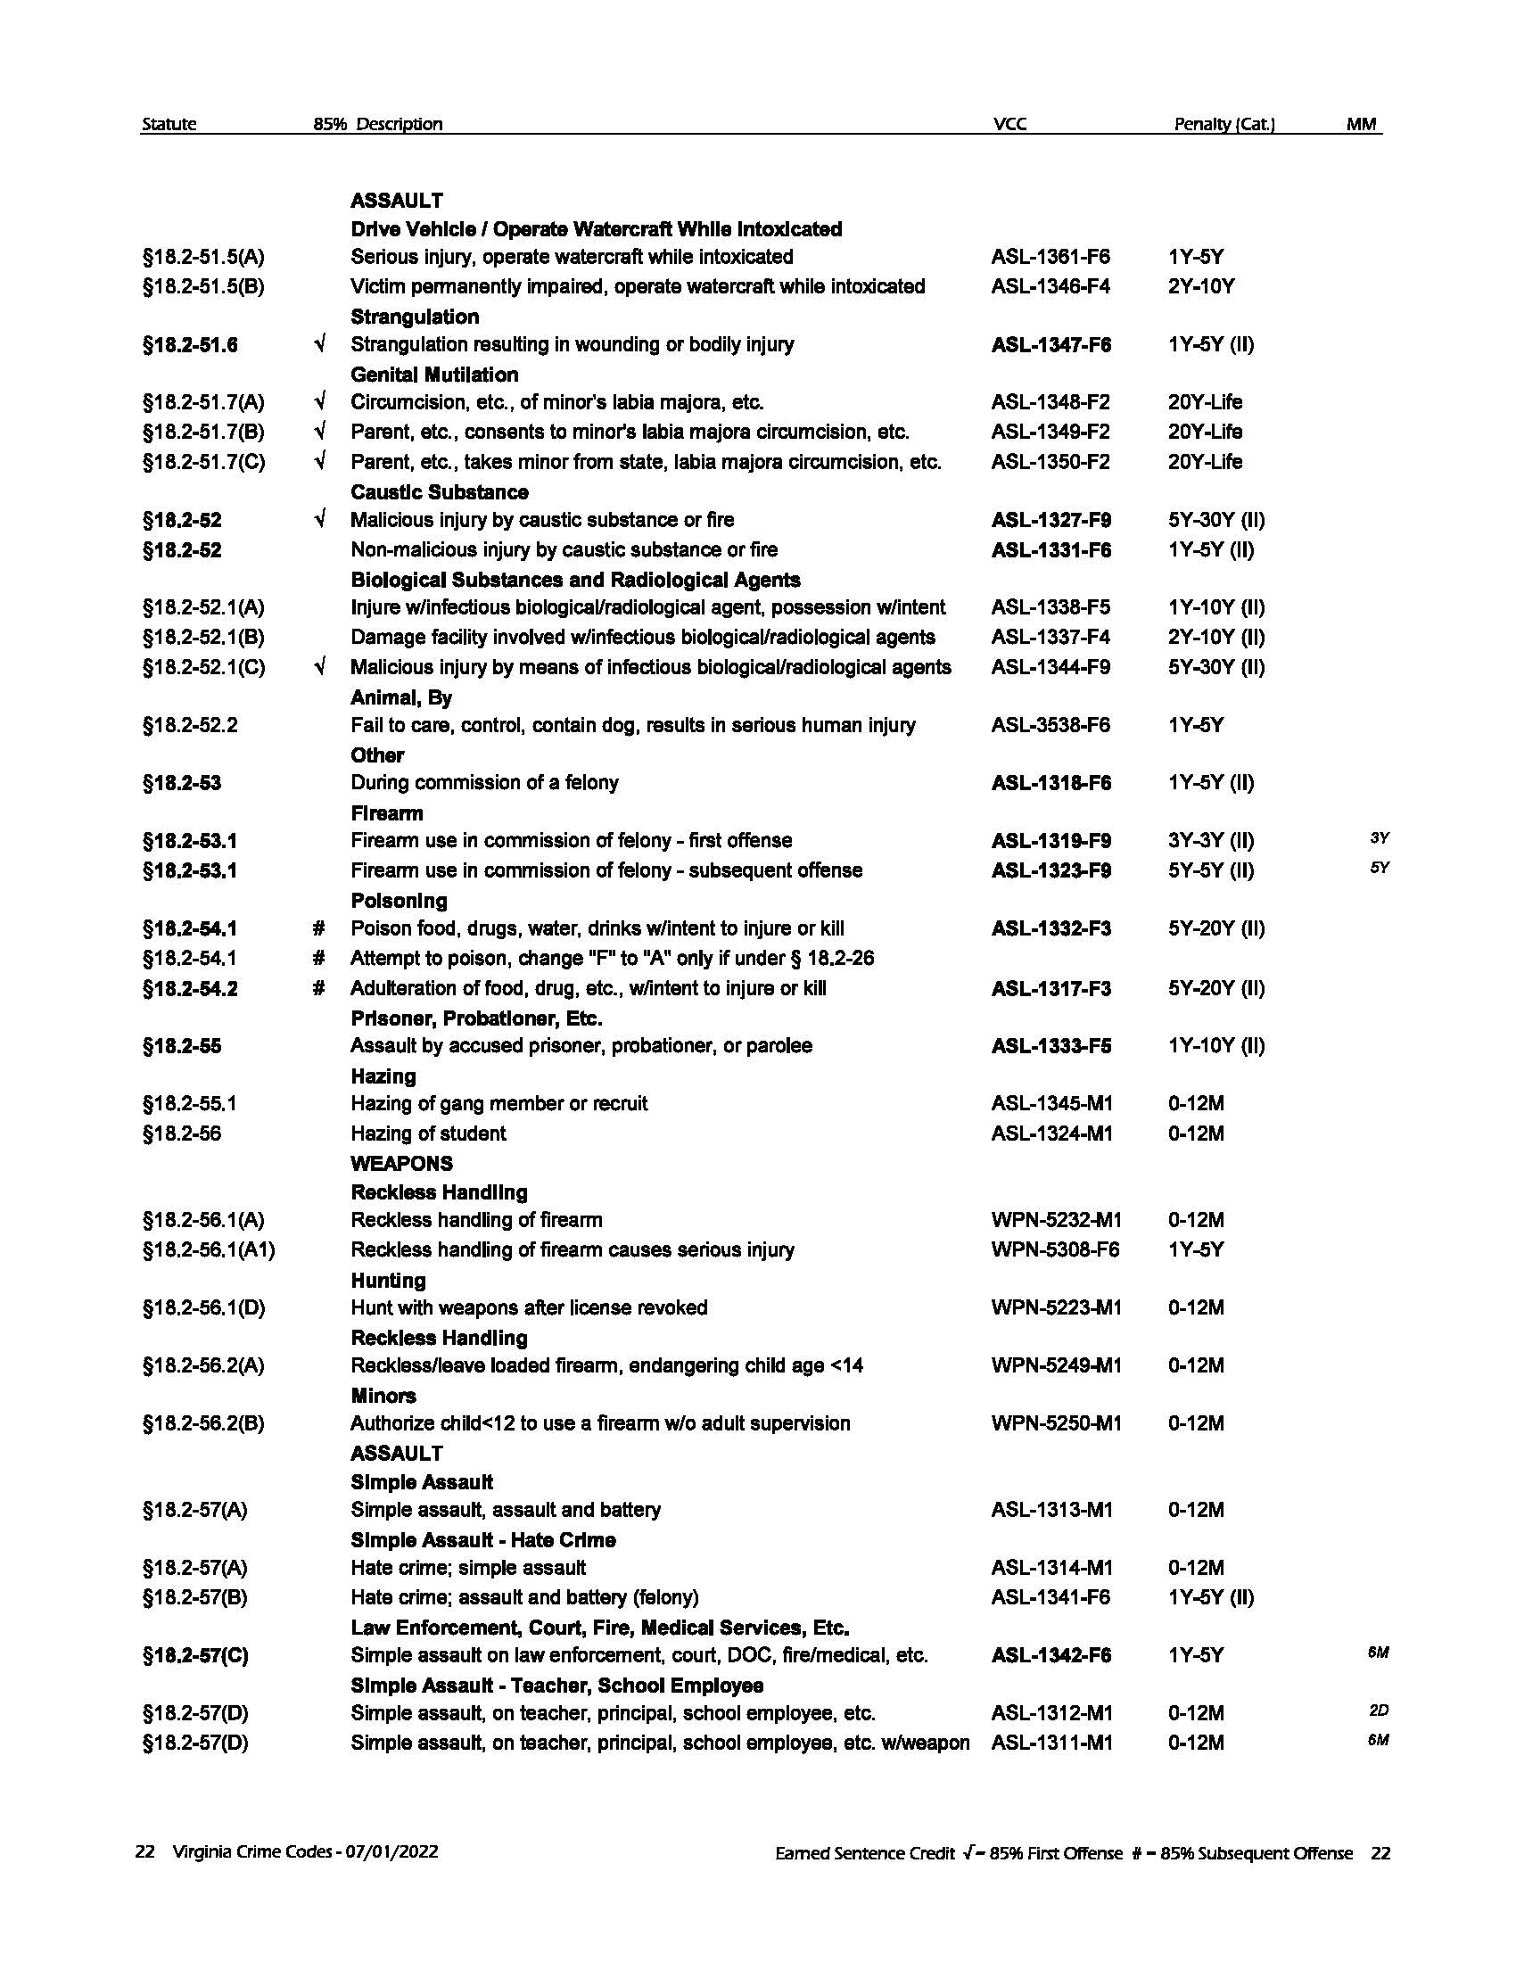
√
Earned Sentence Credit √ = 85% First Offense # = 85% Subsequent Offense
4

Slide 10
AGGRAVATED MURDER
Issue § 18.2-31: The 2021 General Assembly passed legislation to abolish the death penalty. In the legislation, capital murder was redefined as “aggravated murder” and the offense remains a Class 1 felony, but with a maximum penalty of life. Aggravated murder can be scored under current Guidelines rules as an additional offense to another felony that also carries a life maximum penalty. Because previous Guidelines analyses never included capital (now aggravated) murder, the Guidelines scored in such a way may produce recommendations that seem counterintuitive.
Immediate Solution: For any sentencing beginning July 1, 2022, and after users are not to compute a Sentencing Guidelines recommendation for any sentencing event that contains a conviction for completed, attempted or conspired aggravated murder. If the sentencing event includes an aggravated murder conviction, Guidelines preparers should complete only the Cover Sheet and the Case Details Worksheet. SWIFT will mark “No Recommendation” on the Cover Sheet.
The Aggravated Murder Exception Rule rule applies only to offenses under § 18.2-31 (including accessory before the fact/principal in the 2nd degree).

Slide 11
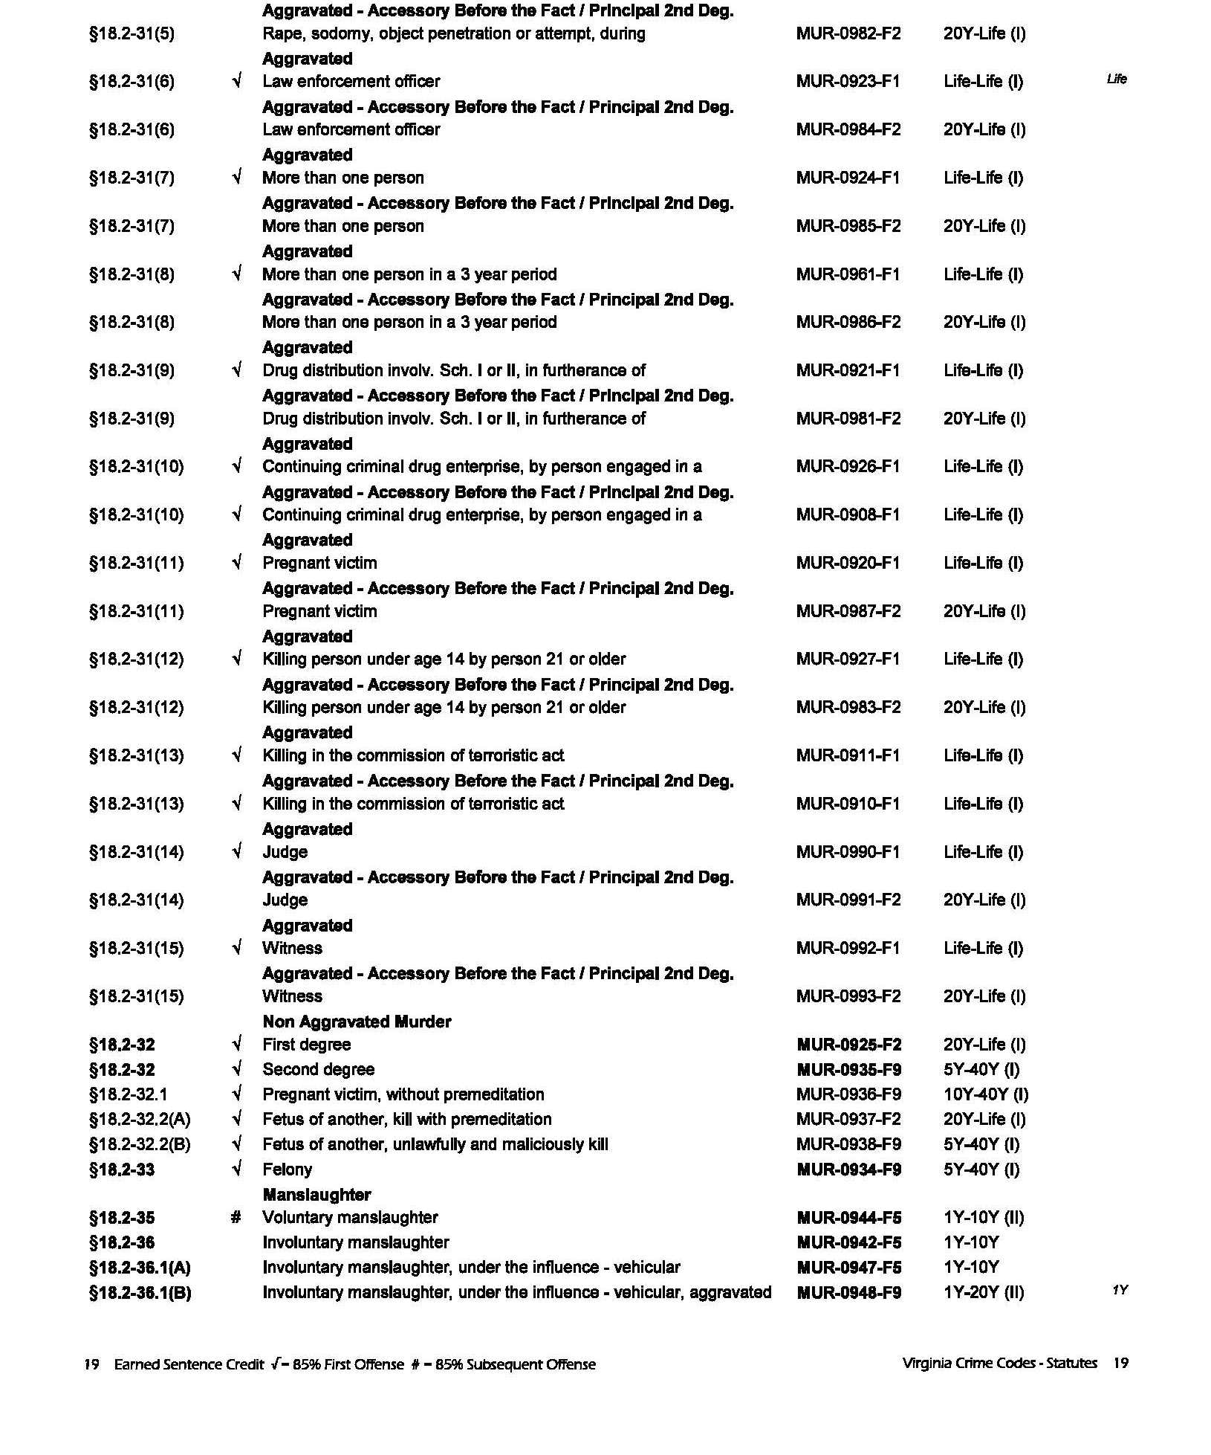
√
Aggravated Murder VCCs
4

Slide 12
Sentencing
Guidelines
2022
Just Added
V C S C

Slide 13
§ 4.1-1100. Possession, etc., of marijuana and marijuana products by persons 21 years of age or older lawful; penalties.
A. Except as otherwise provided in this subtitle and notwithstanding any other provision of law, a person 21 years of age or older may lawfully possess on his person or in any public place not more than one ounce of marijuana or an equivalent amount of marijuana product as determined by regulation promulgated by the Board.
B. Any person who possesses on his person or in any public place marijuana or marijuana products in excess of the amounts set forth in subsection A is subject to a civil penalty of no more than $25 except as otherwise provided in this section. The penalty for any violations of this section by an adult shall be prepayable according to the procedures in § 16.1-69.40:2.
C. With the exception of possession by a person in his residence or possession by a licensee in the course of his duties related to such licensee's marijuana establishment, any person who possesses on his person or in any public place (i) more than four ounces but not more than one pound of marijuana or an equivalent amount of marijuana product as determined by regulation promulgated by the Board is guilty of a Class 3 misdemeanor and, for a second or subsequent offense, a Class 2 misdemeanor and (ii) more than one pound of marijuana or an equivalent amount of marijuana product as determined by regulation promulgated by the Board is guilty of a felony punishable by a term of imprisonment of not less than one year nor more than 10 years and a fine of not more than $250,000, or both.
D. The provisions of this section shall not apply to members of federal, state, county, city, or town law-enforcement agencies, jail officers, or correctional officers, as defined in § 53.1-1, certified as handlers of dogs trained in the detection of controlled substances when possession of marijuana is necessary for the performance of their duties.
The budget includes two new misdemeanor offenses related to marijuana. The VCCs were added after the VCC Book was submitted to the printer. The following two VCCs were added based on 4.1-1100 (C)
MRJ-1921-M3 Possess more than 4 ounces of marijuana Fine
MRJ-1022-M2 Possess more than 4 ounces of marijuana – subsequent 0-6M

Slide 14
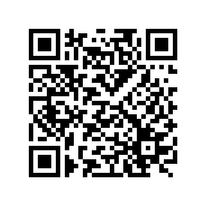
Virginia Criminal Sentencing Commission
100 North 9th Street
Richmond, VA 23219
804.225.4398 (P)
804.393.9588 (T)
www.vcsc.virginia.gov
mobile.vcsc.virginia.gov
Text VCSC to 804.656.5111
SWIFT@vcsc.virginia.gov

